Slide 1


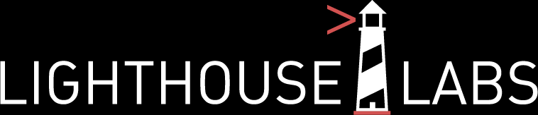
Statistical Modelling with Python by Abi Afolabi 31st July 2023

Slide 2



Project Overview & Goals
Reinforce learning with hands-on experience
Accessing data from website using APIs.
Cleaning and transforming data retrieved via API using Python.
Load data into a database using Python.
Performing EDA, including using both statistics and visualizations.
Identifying trends and patterns in data using statistical models.
Interpreting the results of the statistical models.
Data sources using API

Slide 3
Project Execution Steps
Store Data in SQLite Database
Get Bike locations data using API
Get data for POI within the Bike Locations
Build Model & Interpret
Clean & Transform Data
Merge data & Perform EDA
Notes:
POIs are Restaurant & Employment Services

Slide 4
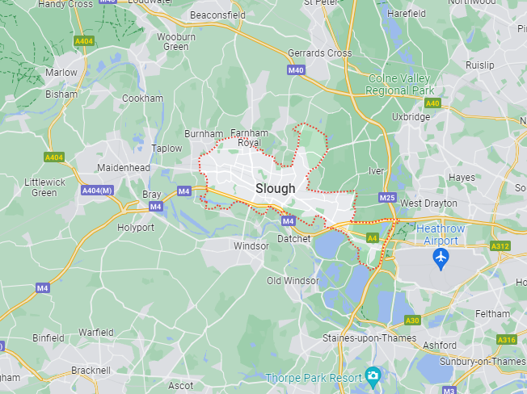
Location of Choice – Slough Points of Interest – Bakery & Employment Agencies
Slough (/slaʊ/) is a town in Bershire, England, in the Thames Valley 20 miles (32 km) west of central London.

Slide 5
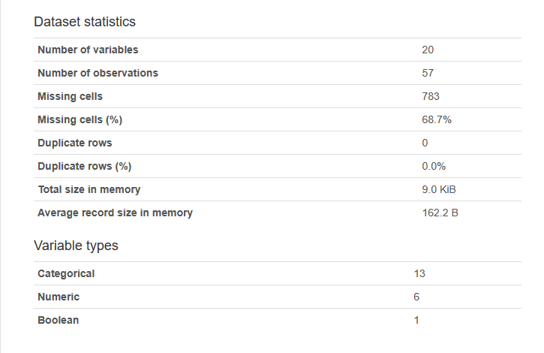
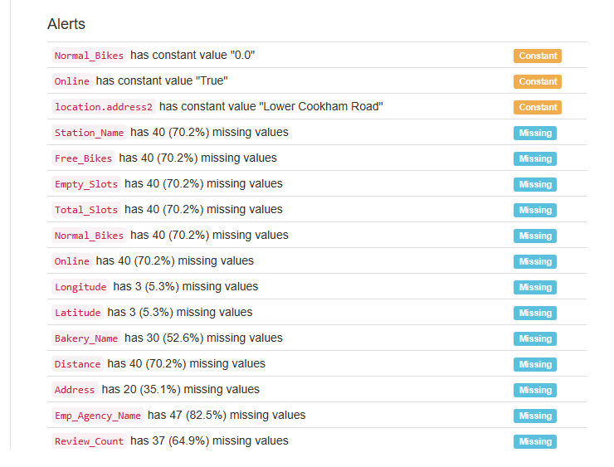
Data Profiling Results

Slide 6
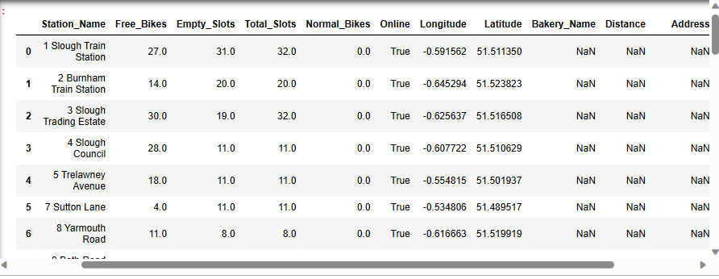
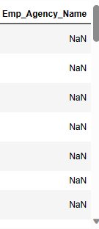
Sample Merged Dataset in Pandas DataFrame

Slide 7
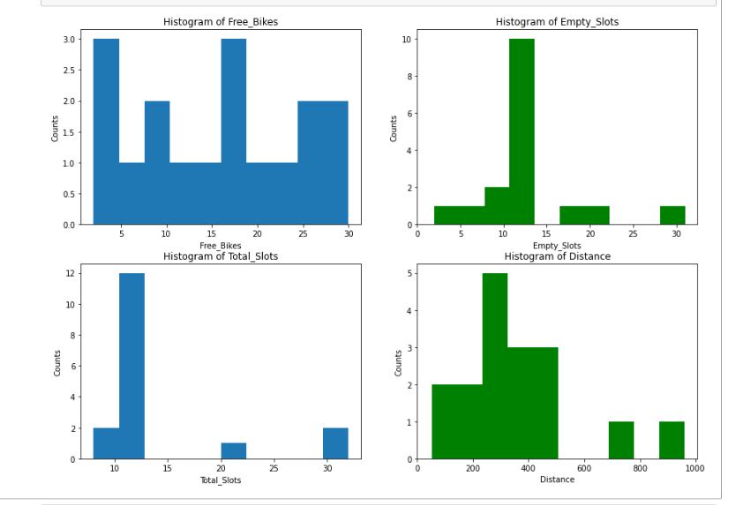
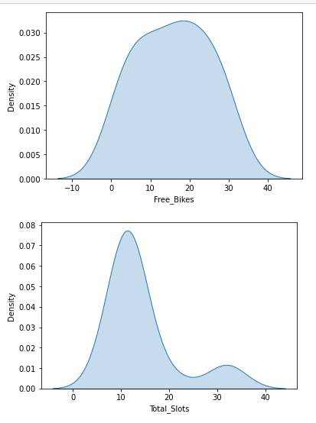
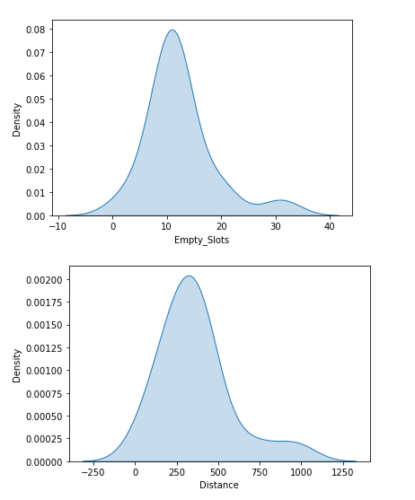
Discoveries from EDA – Histogram & Kde plots
Dataset is mostly symmetrical around the mean

Slide 8
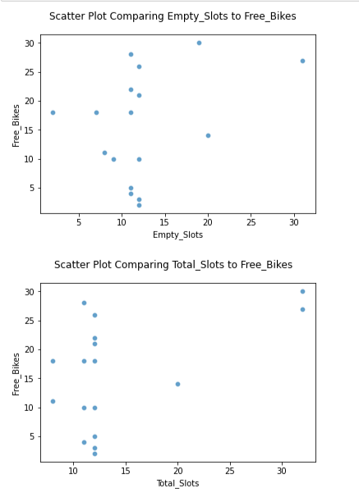
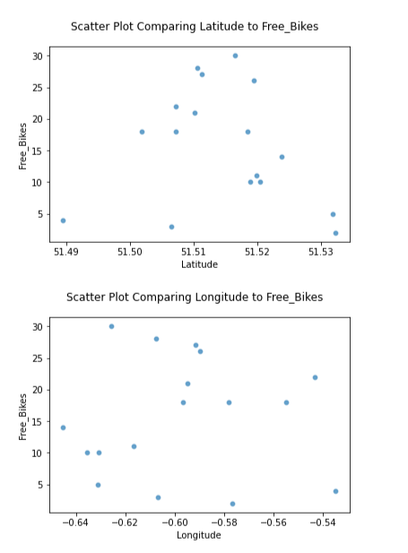
Discoveries from EDA – Scatter plots (Dependent vs Independent)
No distinct correlation between the variables

Slide 9
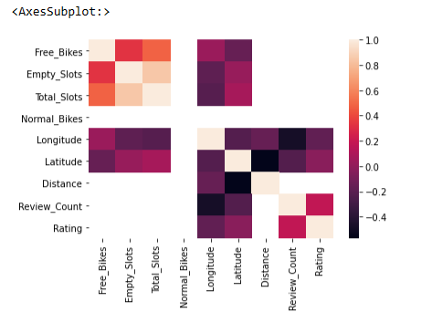
Discoveries from EDA – Correlation Matrix
Very strong correlation between the location of Free_bikes with Distance, Review_Count and Rating

Slide 10
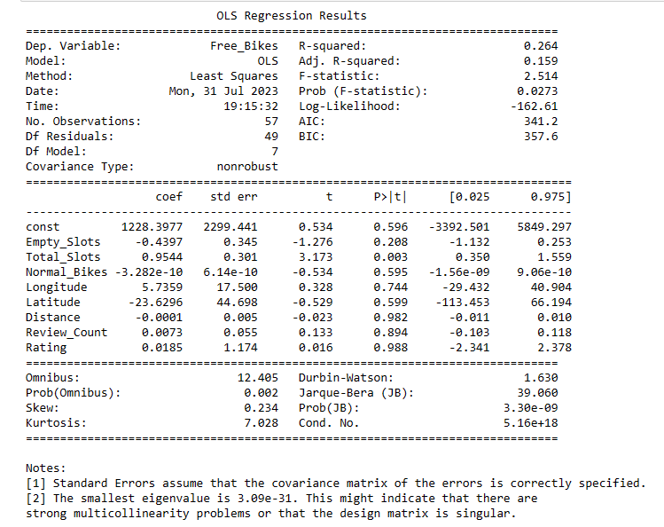
Regression Model
Very low value of adjusted R-squared because the model was penalized for using more independent variable.

Slide 11
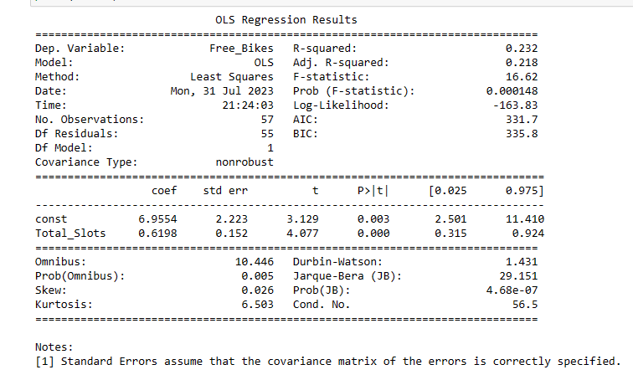
Regression Model with only one variable
value of adjusted R-squared increased slightly, but it is still far from 1 which shows the model quality is low.

Slide 12
Main Challenge – Very Little Time
With more time I will….
Increase search radius to increase data points.
Investigate that the dataset is consistent with all assumptions for a Linear Regression Model.
Find out the definition of the parameters (data columns) for better understanding of the dataset.

Slide 13

Conclusion
Dataset is mostly a normal distribution.
Linearity between Dependent & Independent variables is not distinct.
There exists some collinearity between some of the Independent variables.
Need to include variables that will satisfy Linear model assumptions and improve the model performance.
Notes:
The scatter plots do not really align with the linearity assumption of Linear regression. Therefore linear model might not be able to efficiently explain the data in terms of variability, prediction accuracy.¶

Slide 14

https://github.com/AbiAfolabi/Statistical-Modelling-with-Python_Project-2

Slide 15
Spend 1 min on project flow structure. What were the steps in your project?
Spend 1-2 minutes showing your results.
Explain your regression model
Discuss model outputs
Explain the biggest challenges in 1 min.
what would you do if you had a bit more time?

